Slide 1
An efficient technique for Disease prediction from medical data using data mining algorithm
Presented by:
Name ID
Nafis Md. Zawad 17-34692-2
ASM Ashiqur Rahman Shovon 17-34900-2
MD. Tarek Lehaz Tabid 17-34240-1

Slide 2
Introduction
The world's biggest modern outbreak was uncovered in the mid-twentieth century, and since then, the world's populace has been haunted by the Severe Acute Respiratory Syndrome Coronavirus, or literally, as the citizens affectionately term it, "Covid-19." The negative effects of this disease have harmed the psychological tranquillity of the whole world. People are combining their skills to develop numerous ideas and techniques for fighting against this disease which have taken numerous lives.

Slide 3
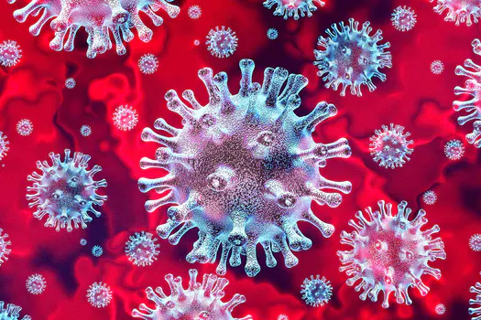
What is corona virus?
COVID-19 is a disease caused by SARS-CoV-2 which triggers a respiratory tract infection. It can affect upper respiratory tract or lower respiratory tract.
It spreads mainly through person-to-person contact.
Infections range from mild to deadly. Deadly cases are seemed to be incurable.
SARS-CoV-2 is one of seven types of coronavirus, including the ones that cause severe diseases like Middle East respiratory syndrome (MERS) and sudden acute respiratory syndrome (SARS).
The other coronaviruses cause most of the colds but aren’t a serious threat for otherwise healthy people.

Slide 4
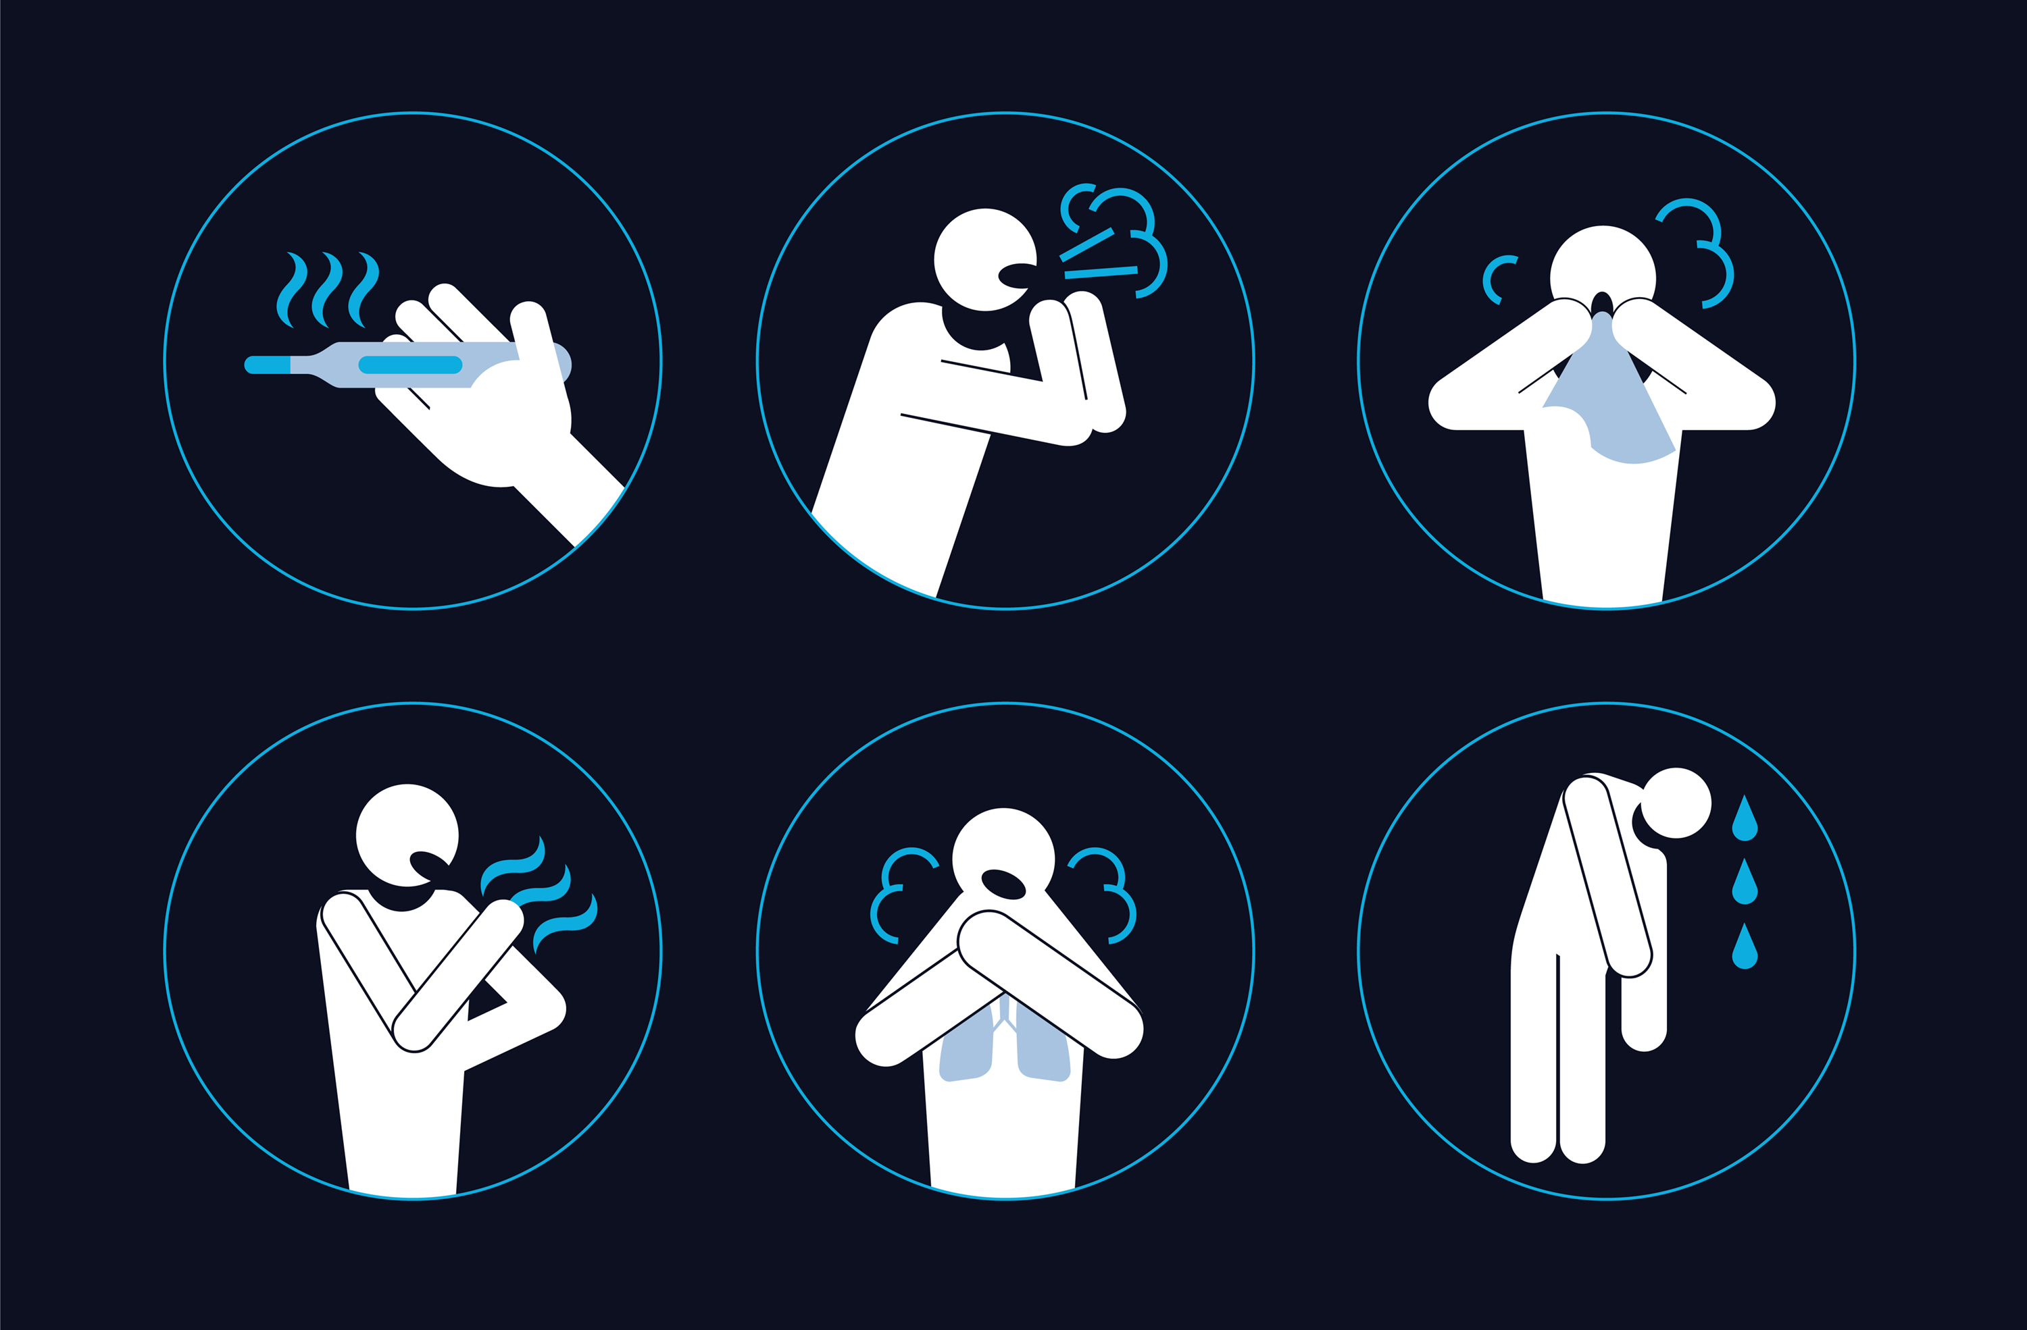
Symptoms of corona virus
There are many symptoms of corona virus:
fever
dry cough
tiredness
difficulty breathing or shortness of breath
chest pain or pressure
loss of speech or movement
sore throat
diarrhea
conjunctivitis
headache

Slide 5
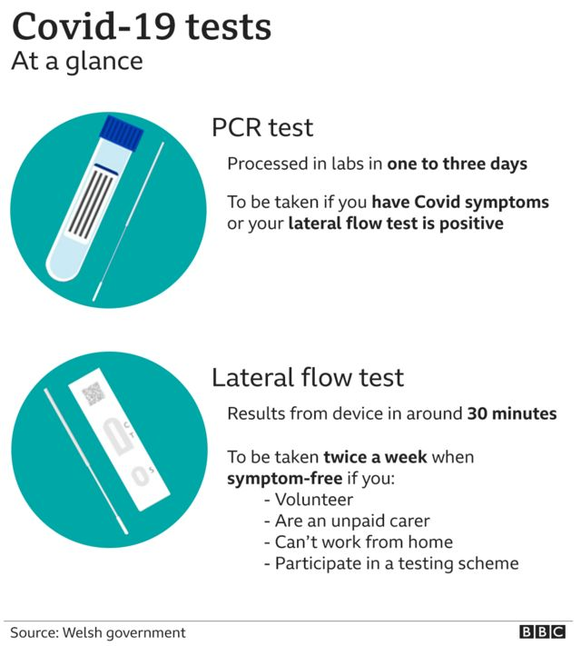
Corona detection using clinical method
Molecular test
Antigen test
Antibody test
PCR test
Lateral flow test

Slide 6
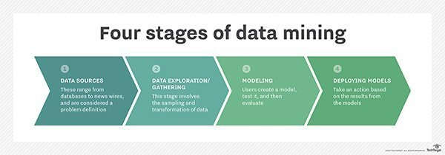
What is data mining?
Data mining is the process of analyzing massive volumes of data to discover businesses intelligence that helps companies solve problems, mitigate risks, and seize new opportunities.
Data mining is used in predictive models.

Slide 7
Objective
To understand the problem in the existing models and find out about the issues that caused for it.
Stating problems for determining a COVID infected patient.
Propose model for the prediction of the disease.
Proposing solutions for the problem.
Finally, developing an efficient model for the solution.

Slide 8
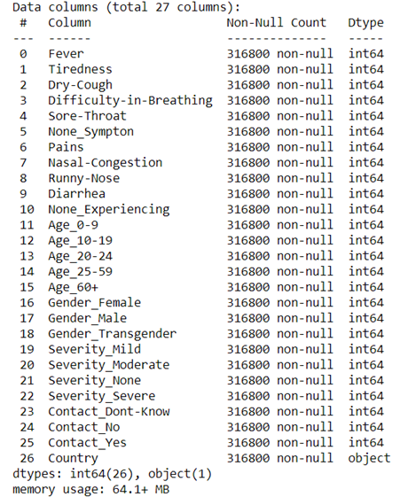
Dataset of Covid 19
The dataset contains many irregular, null and nominal values.
The dataset contains variables

Slide 9
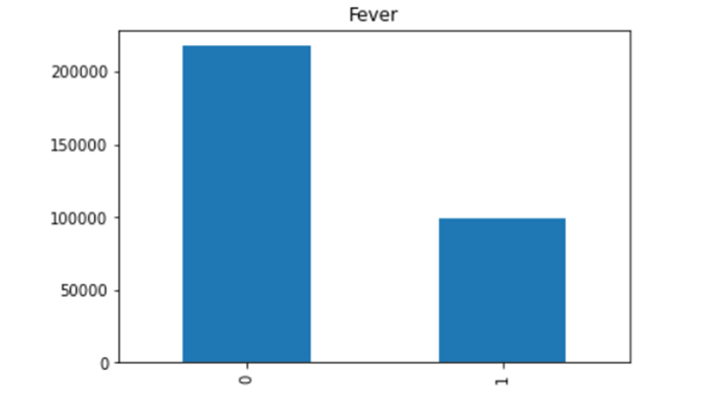
Dataset analysis
This figure shows how many patients having fever as a symptom.

Slide 10
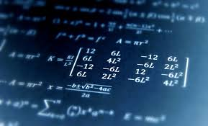
Data mining algorithms
In our thesis paper, we have implemented three data mining algorithms:
Logistic Regression
Decision Tree
Random Forest

Slide 11
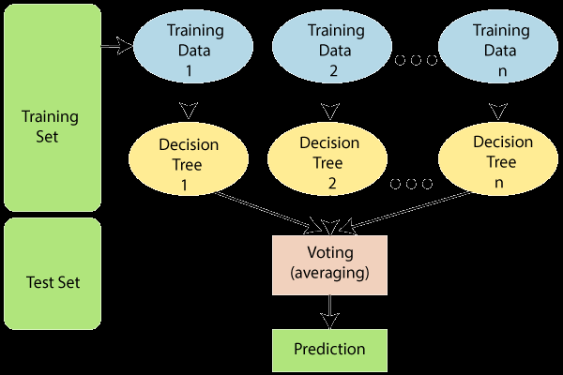
Random forest implemented in the model
It avoids overfitting by averaging or integrating the outcomes of multiple decision trees.
Random forests do better than a single decision tree over a wide variety of data elements.
The variance of a random forest is lower than that of a single decision tree.
Random forests are very adaptable and have a high level of precision.
The random forest algorithm does not require data scaling. It retains good precision even though data is provided without scaling.
Besides in our model random forest took less time in processing time than other algorithms.

Slide 12
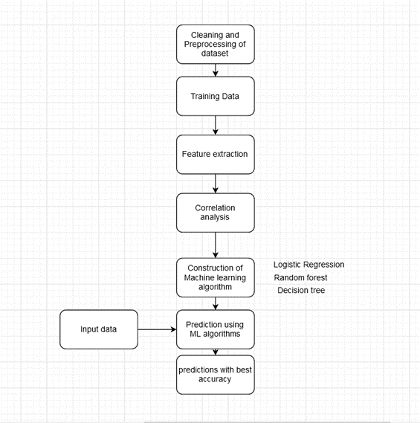
Our proposed method

Slide 13
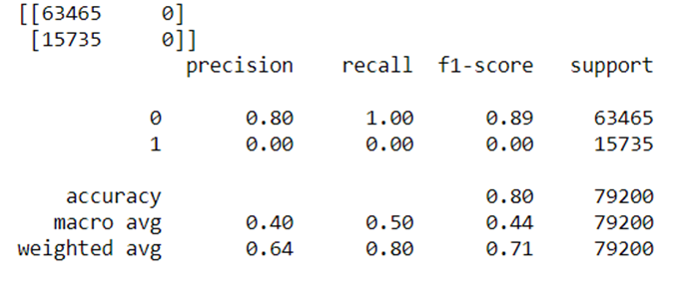
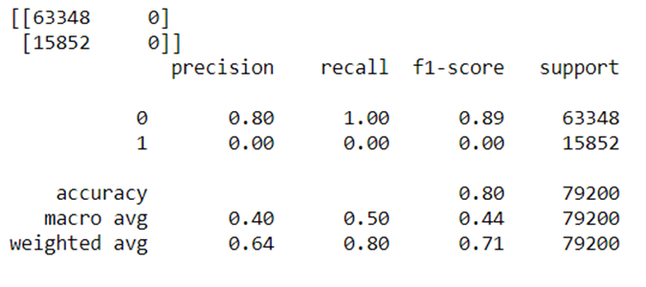
Prediction for ages between 10-19
Results
Prediction for ages between 0-9

Slide 14
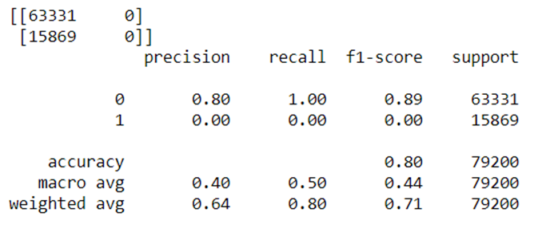
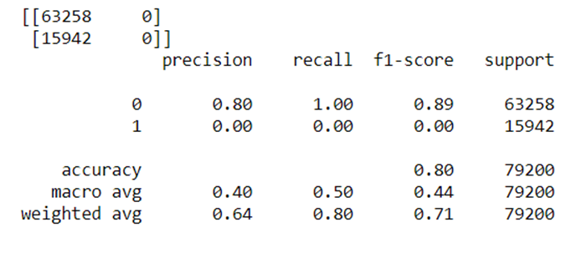
Results
Prediction for ages between 20-24
Prediction for ages between 25-59

Slide 15
Conclusion
We have got an accuracy of 80% in predicting corona virus using machine learning algorithm (Random Forest).
Due to inadequate data on covid our proposed model have shown low accuracy.

Slide 16
Thank You

